Slide 1

Vocabulary in Reading Study
(VIRS)

Slide 2
Our Team
Capstone 2 Capstone I
Oscar Molina Adrian Bustos
Isaac Lomax Denae Miller
Jeffrey Quispe Evers Perez
Lucas Stumpf Gino Surace
Jose Rodriguez Gentman Tan
Mentor: Eric Dwyer
Instructor: Dr. Masoud Sadjadi, Florida International University
Senior Project
Denzel Merrell

Slide 3
The Problem
English Language Learners (ELL) constantly face a challenge:
Not having an all-encompassing practical solution to learning vocabulary.
It is difficult to find options for ELL and their educators that allows them to:
Measure the difficulty level of text, which can either challenge or discourage the learner.
See definitions of words in a text that they are interested to learn.
Chose words they want to focus on based on categories such as frequently used words.

Slide 4
What is VIRS?

Slide 5
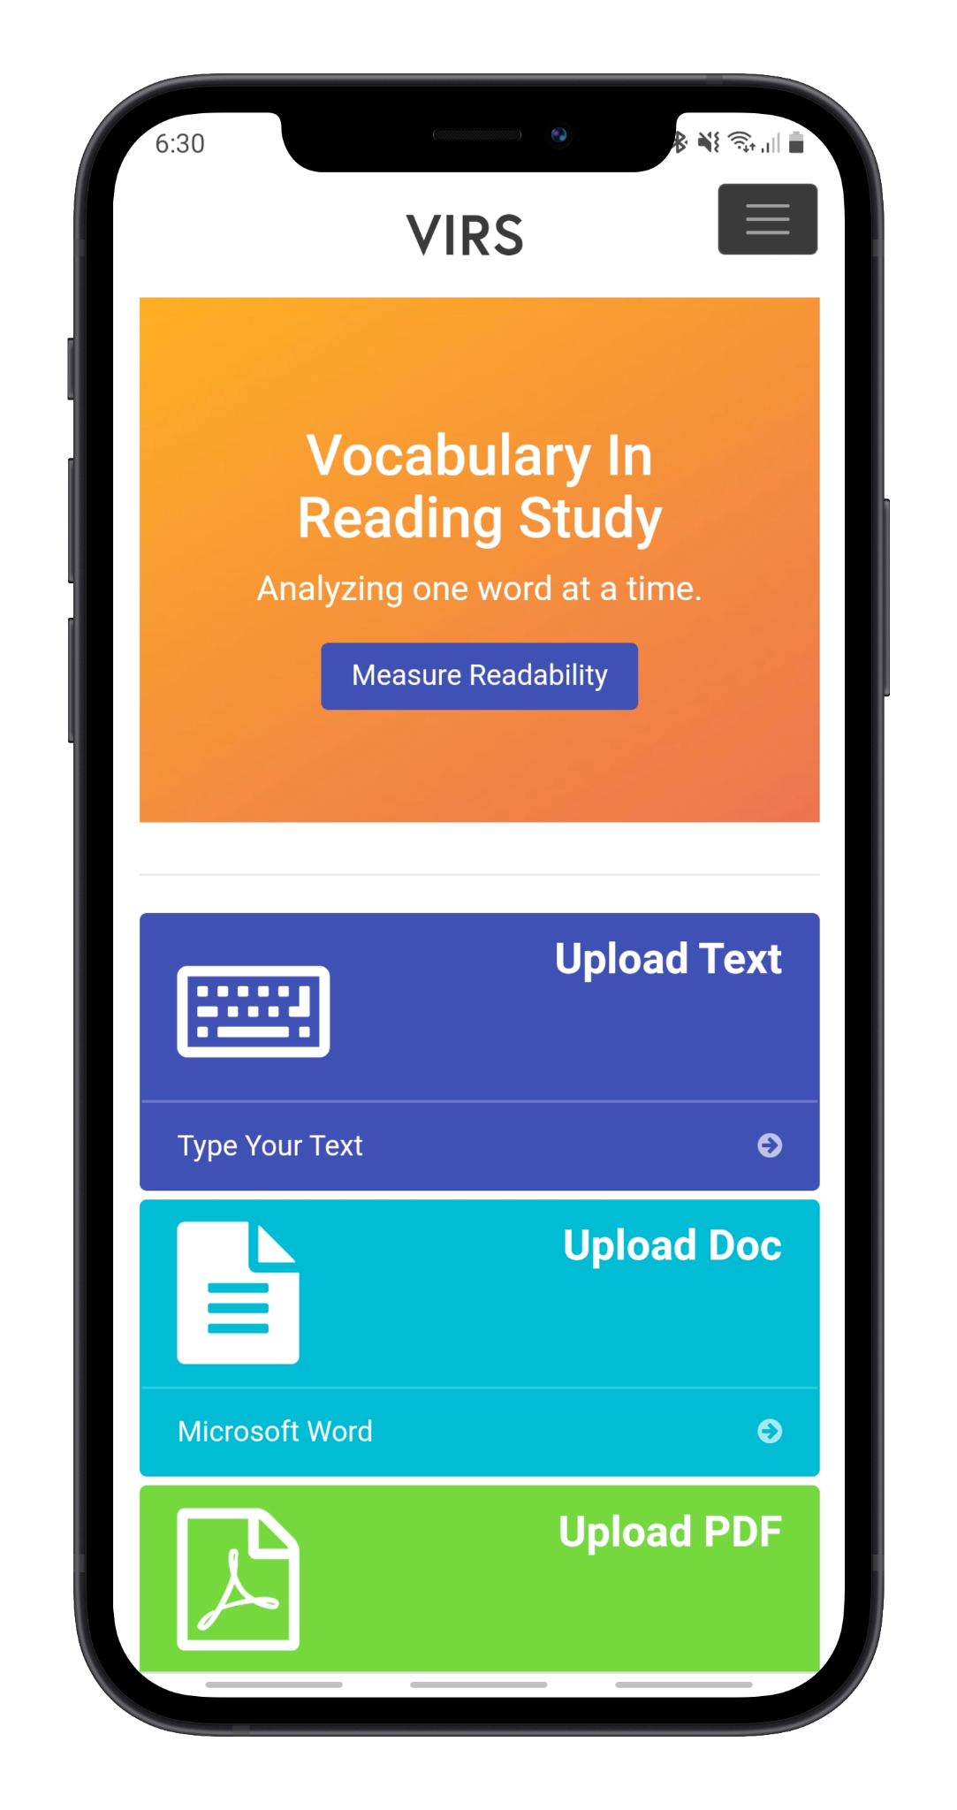
VIRS is a web application that...
Analyzes the user’s upload document can categorized the words by difficulty
Allows the user to easily view the definition of words
Pinpoint words that they would like to focus on based on their frequency and category
Assess their learning through vocabulary quizzes

Slide 6




Technologies
Angular Model View Controller is used for the front end.
Backend is written in Java.
MySQL is used as the database and the data queries are auto generated by Spring Data JPA.
The application is deployed on AWS elastic beanstalk.

Slide 7
Website Overview
Page | Functionality
Home page | Greets the user. Gives option to upload a file to be analyzed
Analyze Text: Enhanced Text | Color codes words based on difficulty.
Analyze Text: Statistics | Provides an in-depth analysis on the difficulty of the text and frequency of certain words.
Word Search | Gives learners a list of words that they should learn and allows them to easily see the definition.
iTranslate | Translates a given text to a number of different languages
Register/User Recovery | Create an account and retrieve lost credentials.

Slide 8
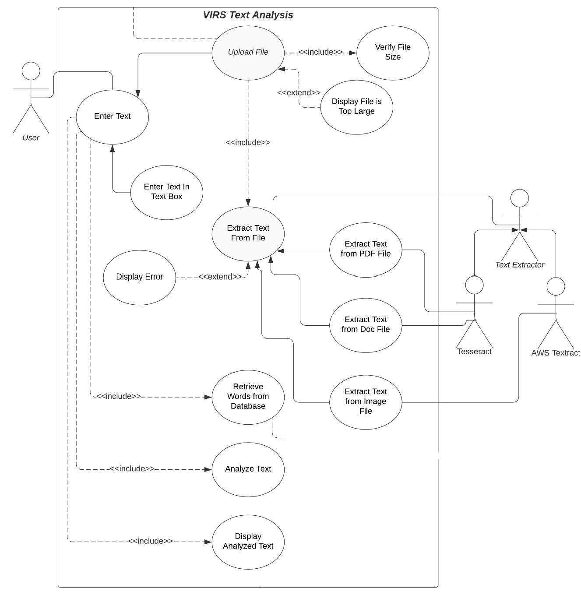
This is how the website functions for text analysis.

Slide 9
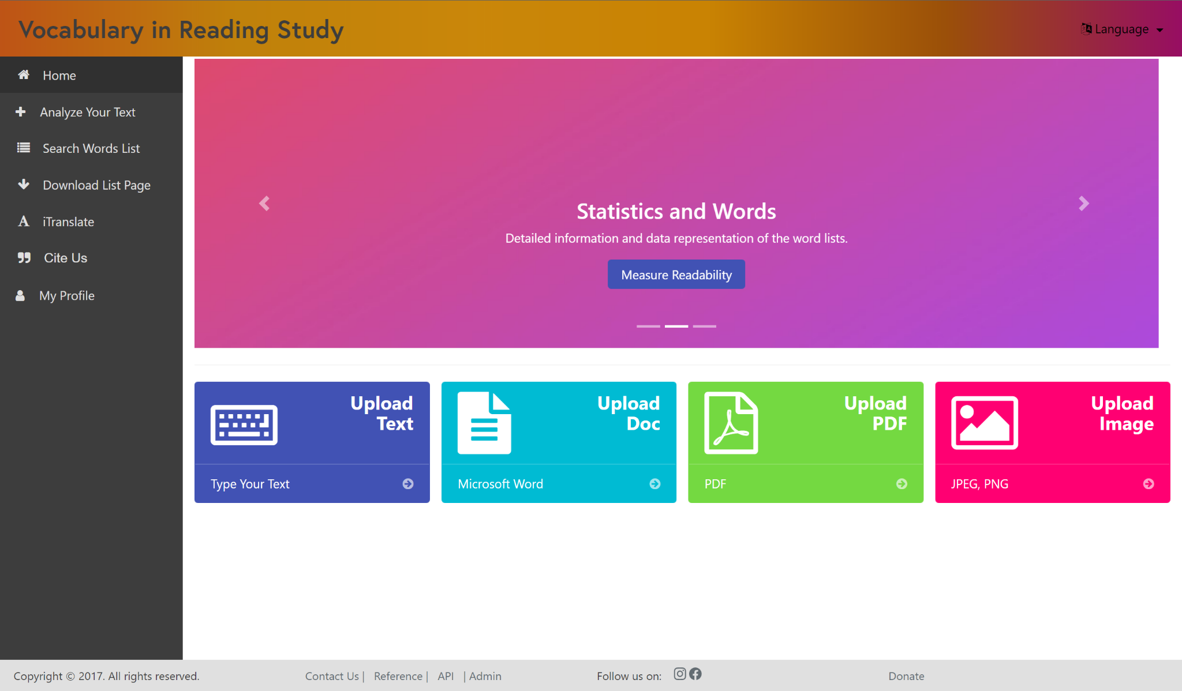
Home Page

Slide 10
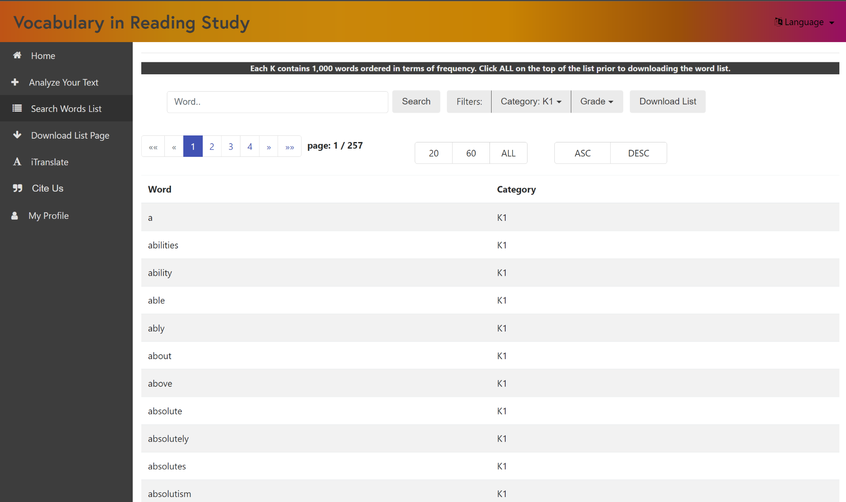
Word Search

Slide 11
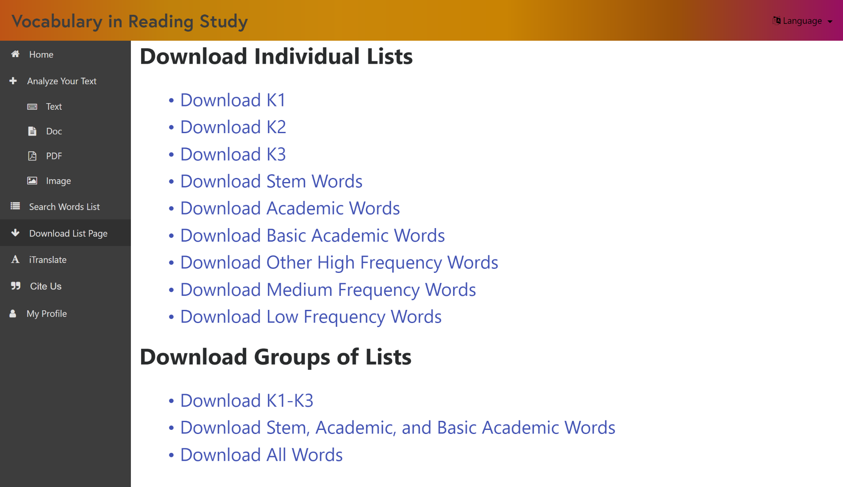
Download Words List

Slide 12
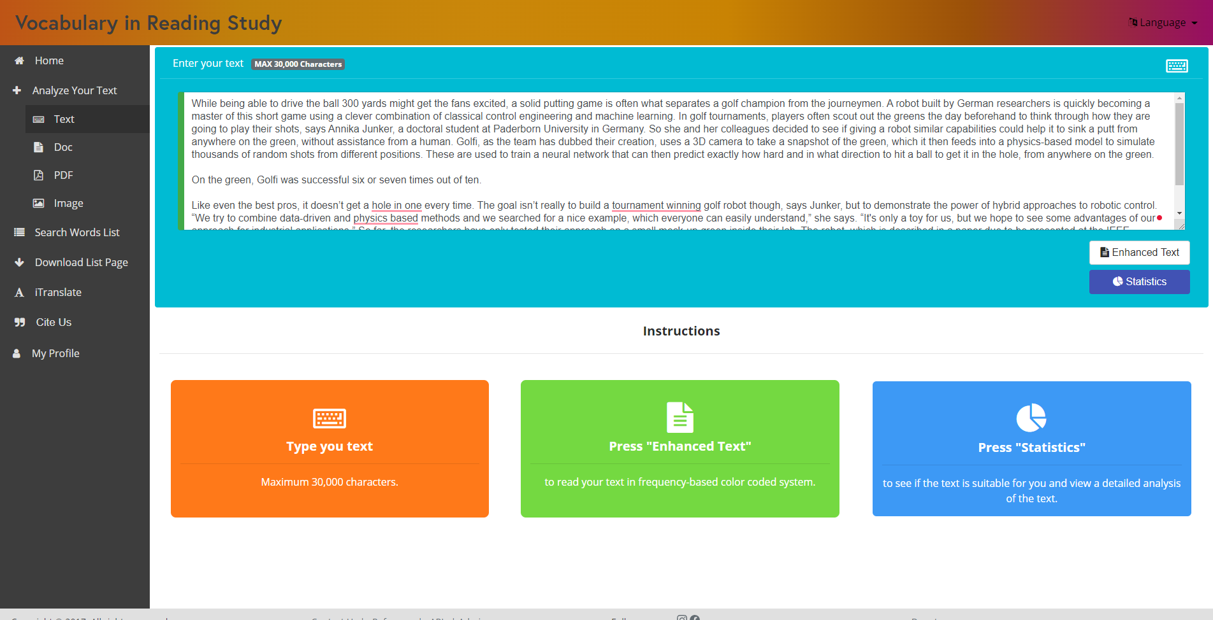
Analyze Text

Slide 13
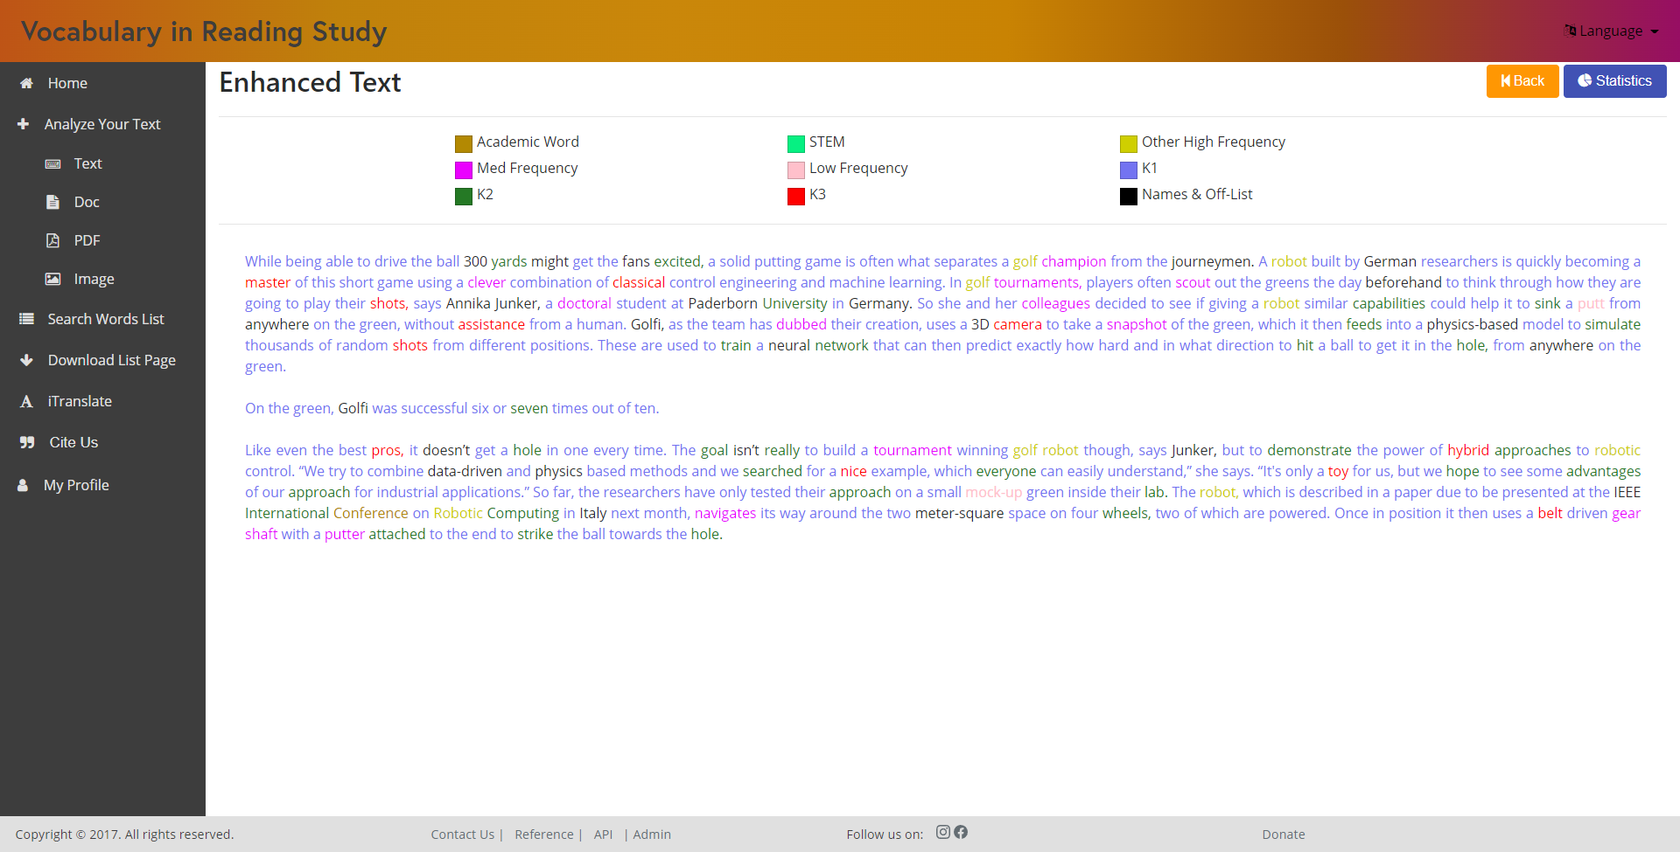
Enhanced Text

Slide 14
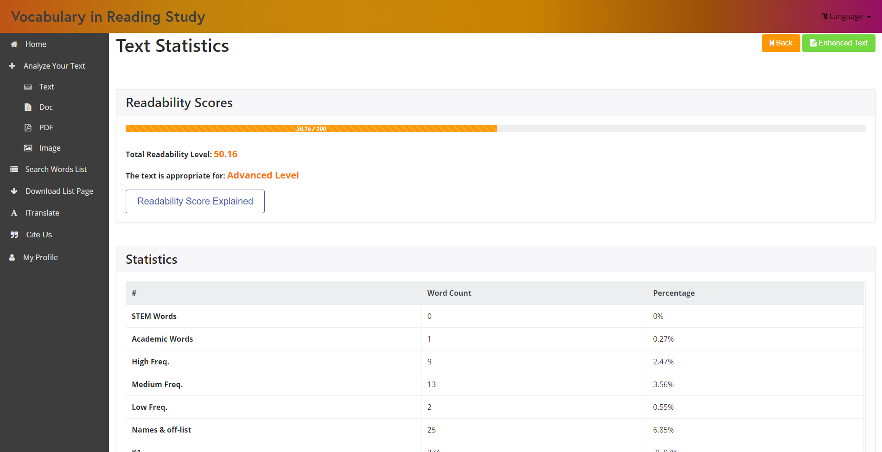
Text Statistics

Slide 15
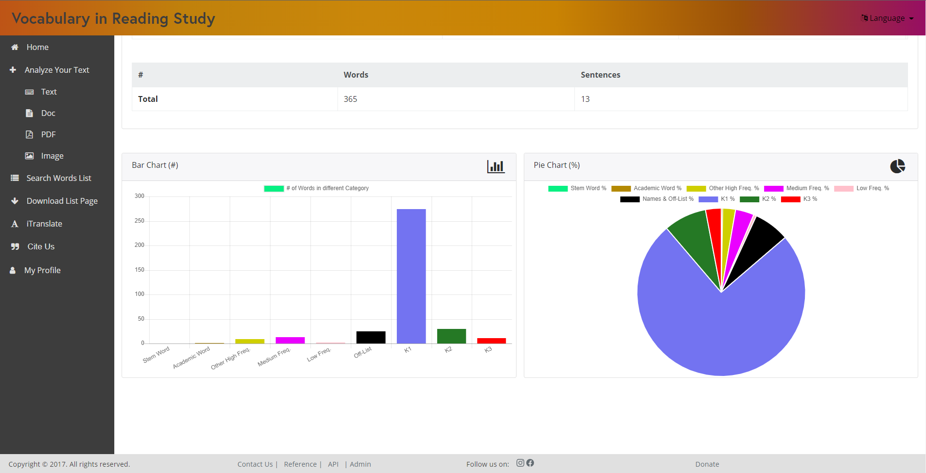
Text Statistics

Slide 16
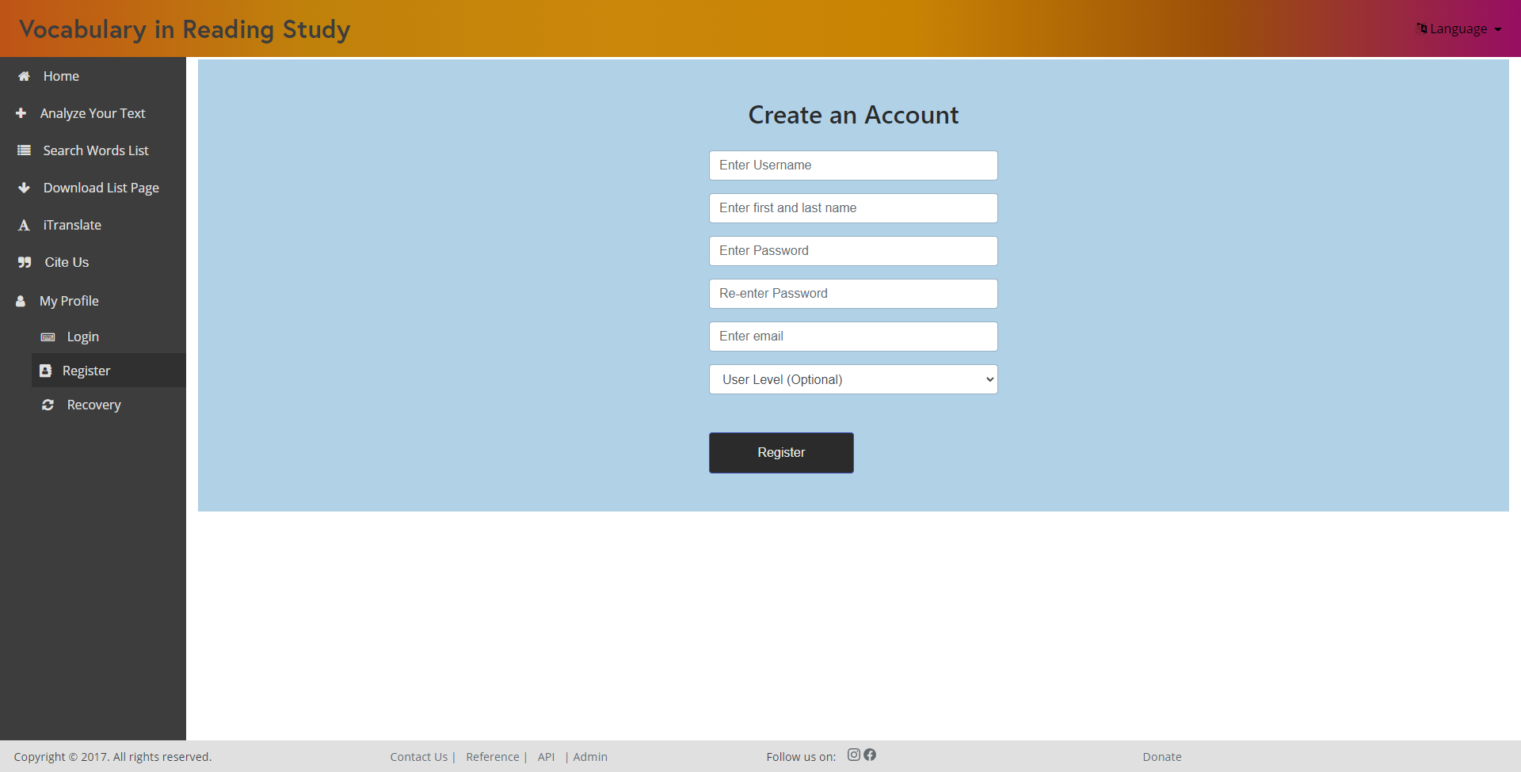
Register

Slide 17
Changes
User Interface

Slide 18
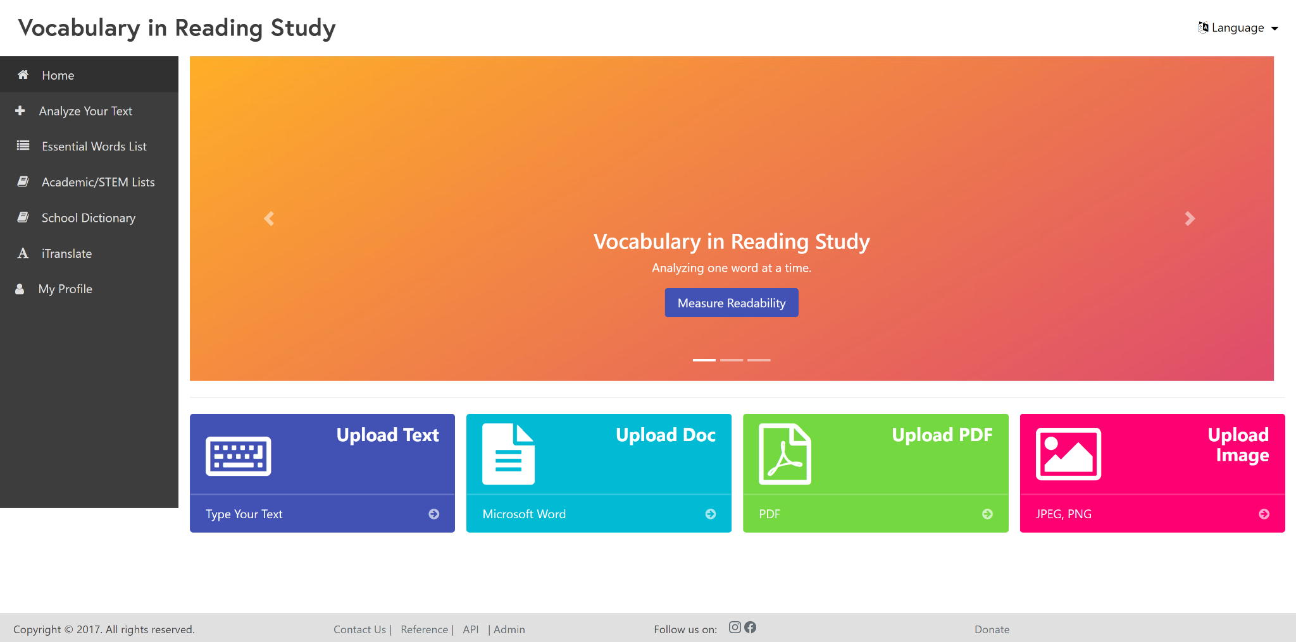
Old Design

Slide 19
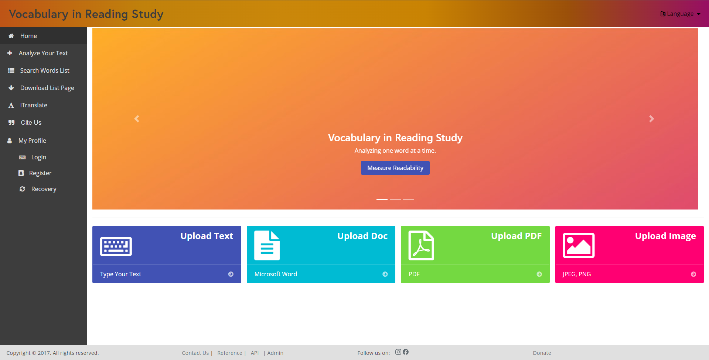
New Design

Slide 20
Changes
Defaulting of Words

Slide 21
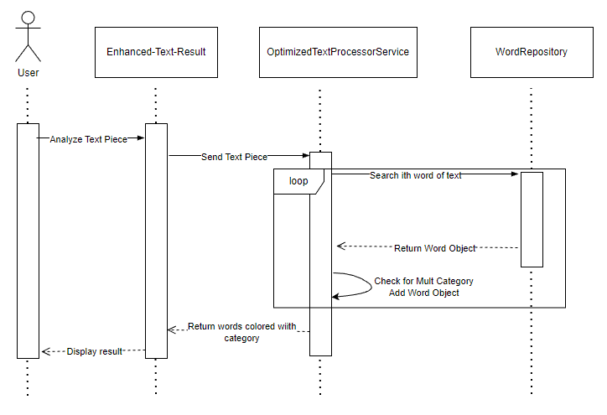
This is how words are defaulted.

Slide 22
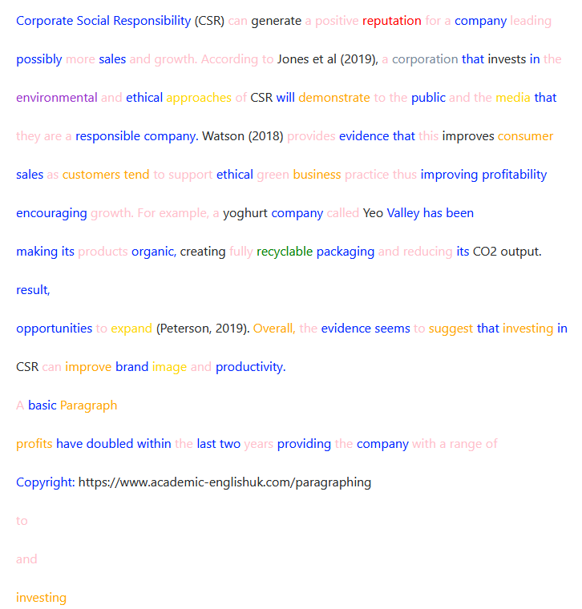
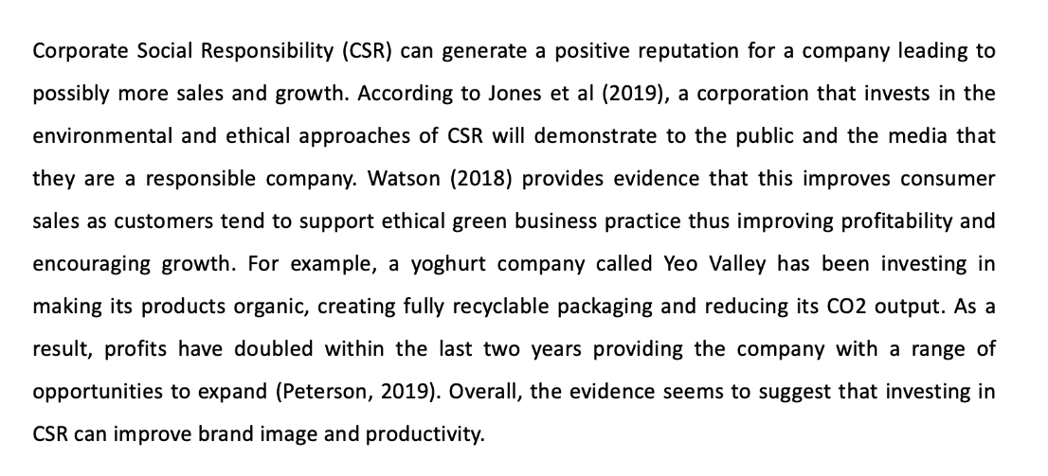
Fixing Word Defaulting Process
Problems
Words with multiple categories do not default to their correct category.
Solution
Implementation of a system defaults words to their category of highest priority.
test paragraph - www.academic-englishuk.com/paragraphing

Slide 23
Changes
Removal of Redundant Components

Slide 24
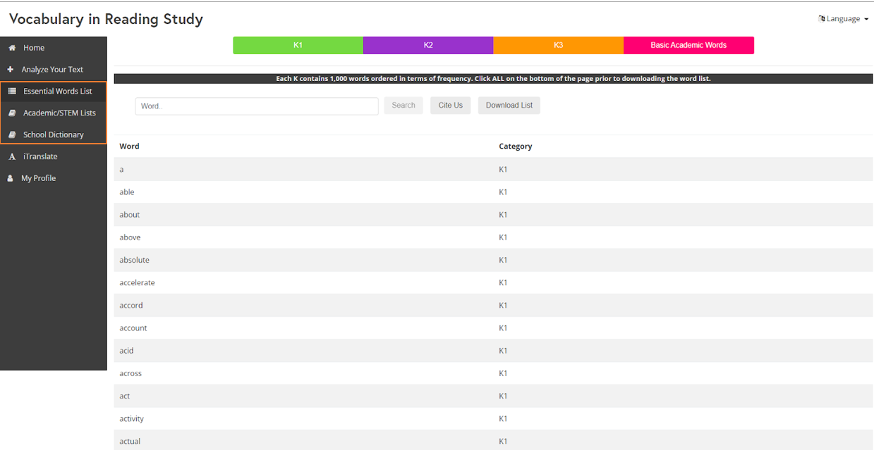
Website has 3 separate searching tabs

Slide 25
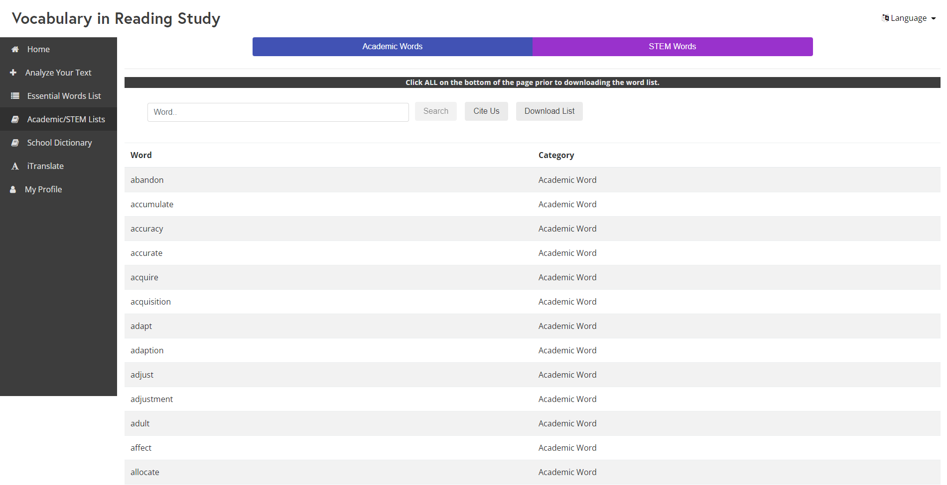
Website has 3 separate searching tabs

Slide 26
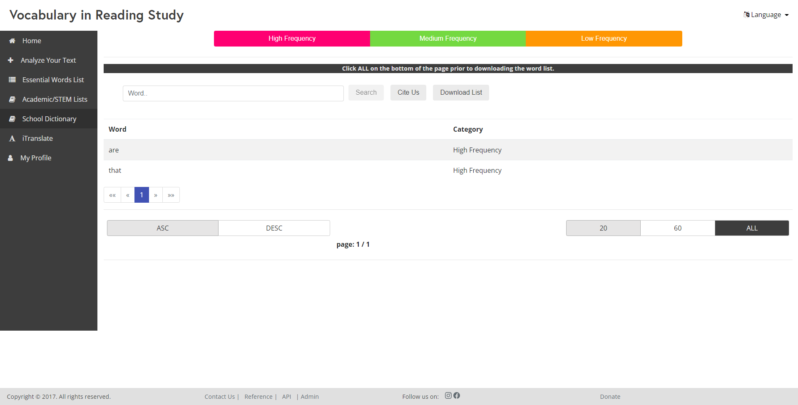
Website has 3 separate searching tabs

Slide 27
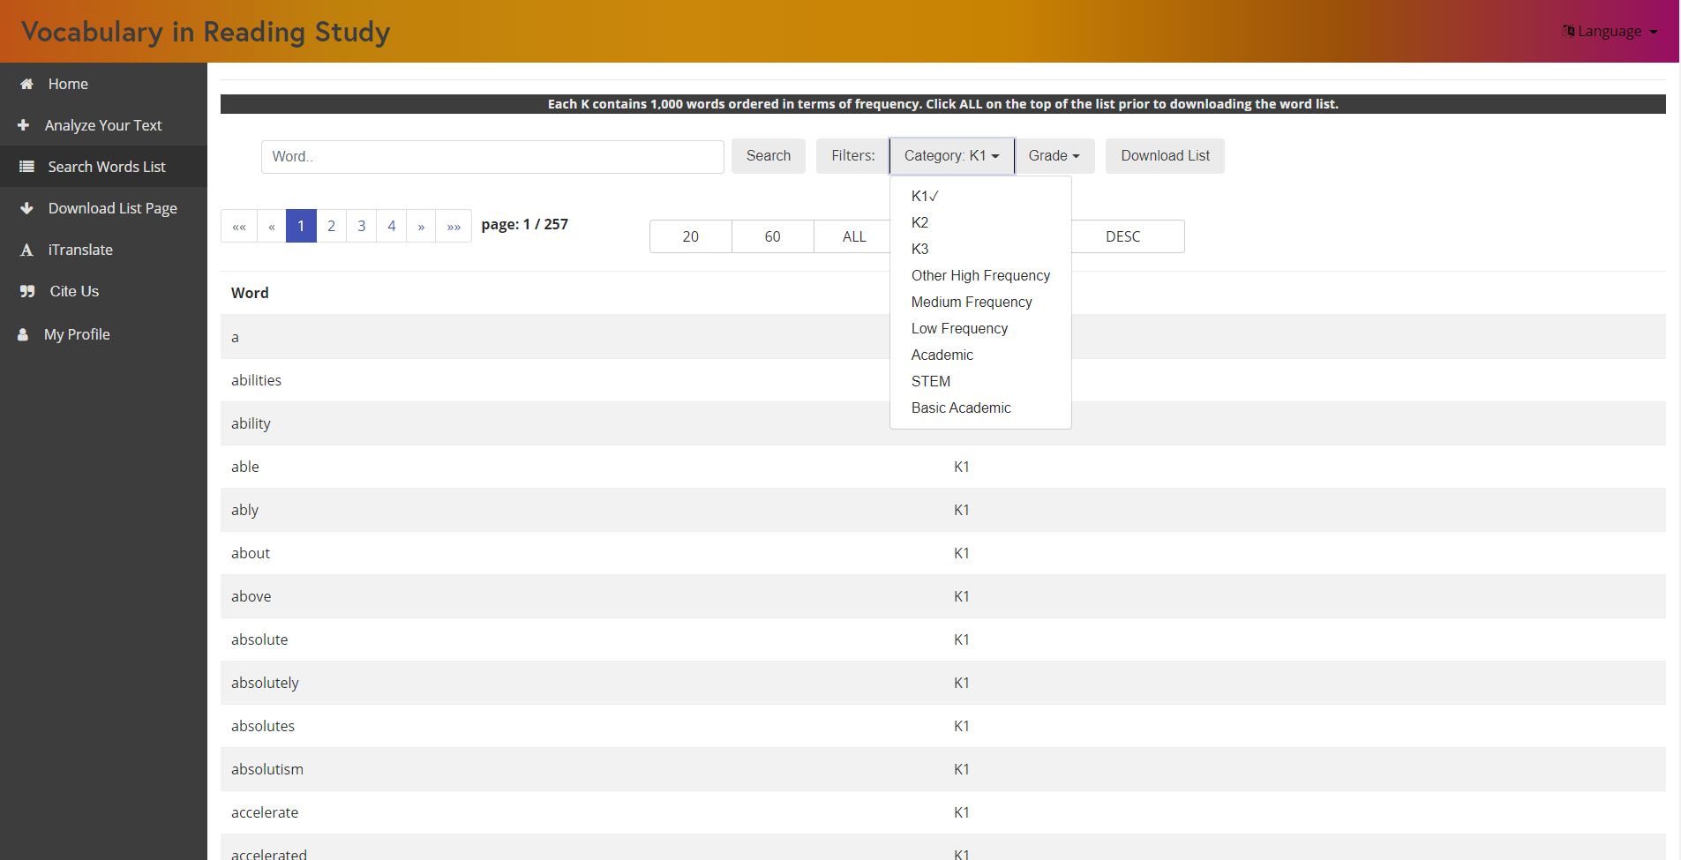
Website has 3 separate searching tabs
Problem
User has to search for words while in the exact category tab the word appears in.
Solution
Change the search component so that it searches in all categories and also added a filter.

Slide 28
Changes
Downloads for Word Lists

Slide 29
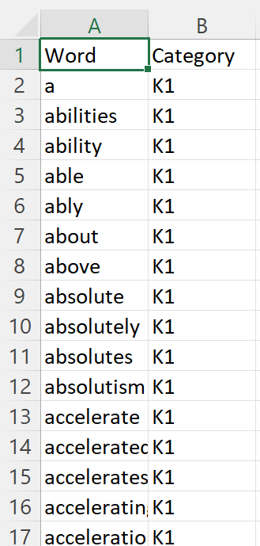
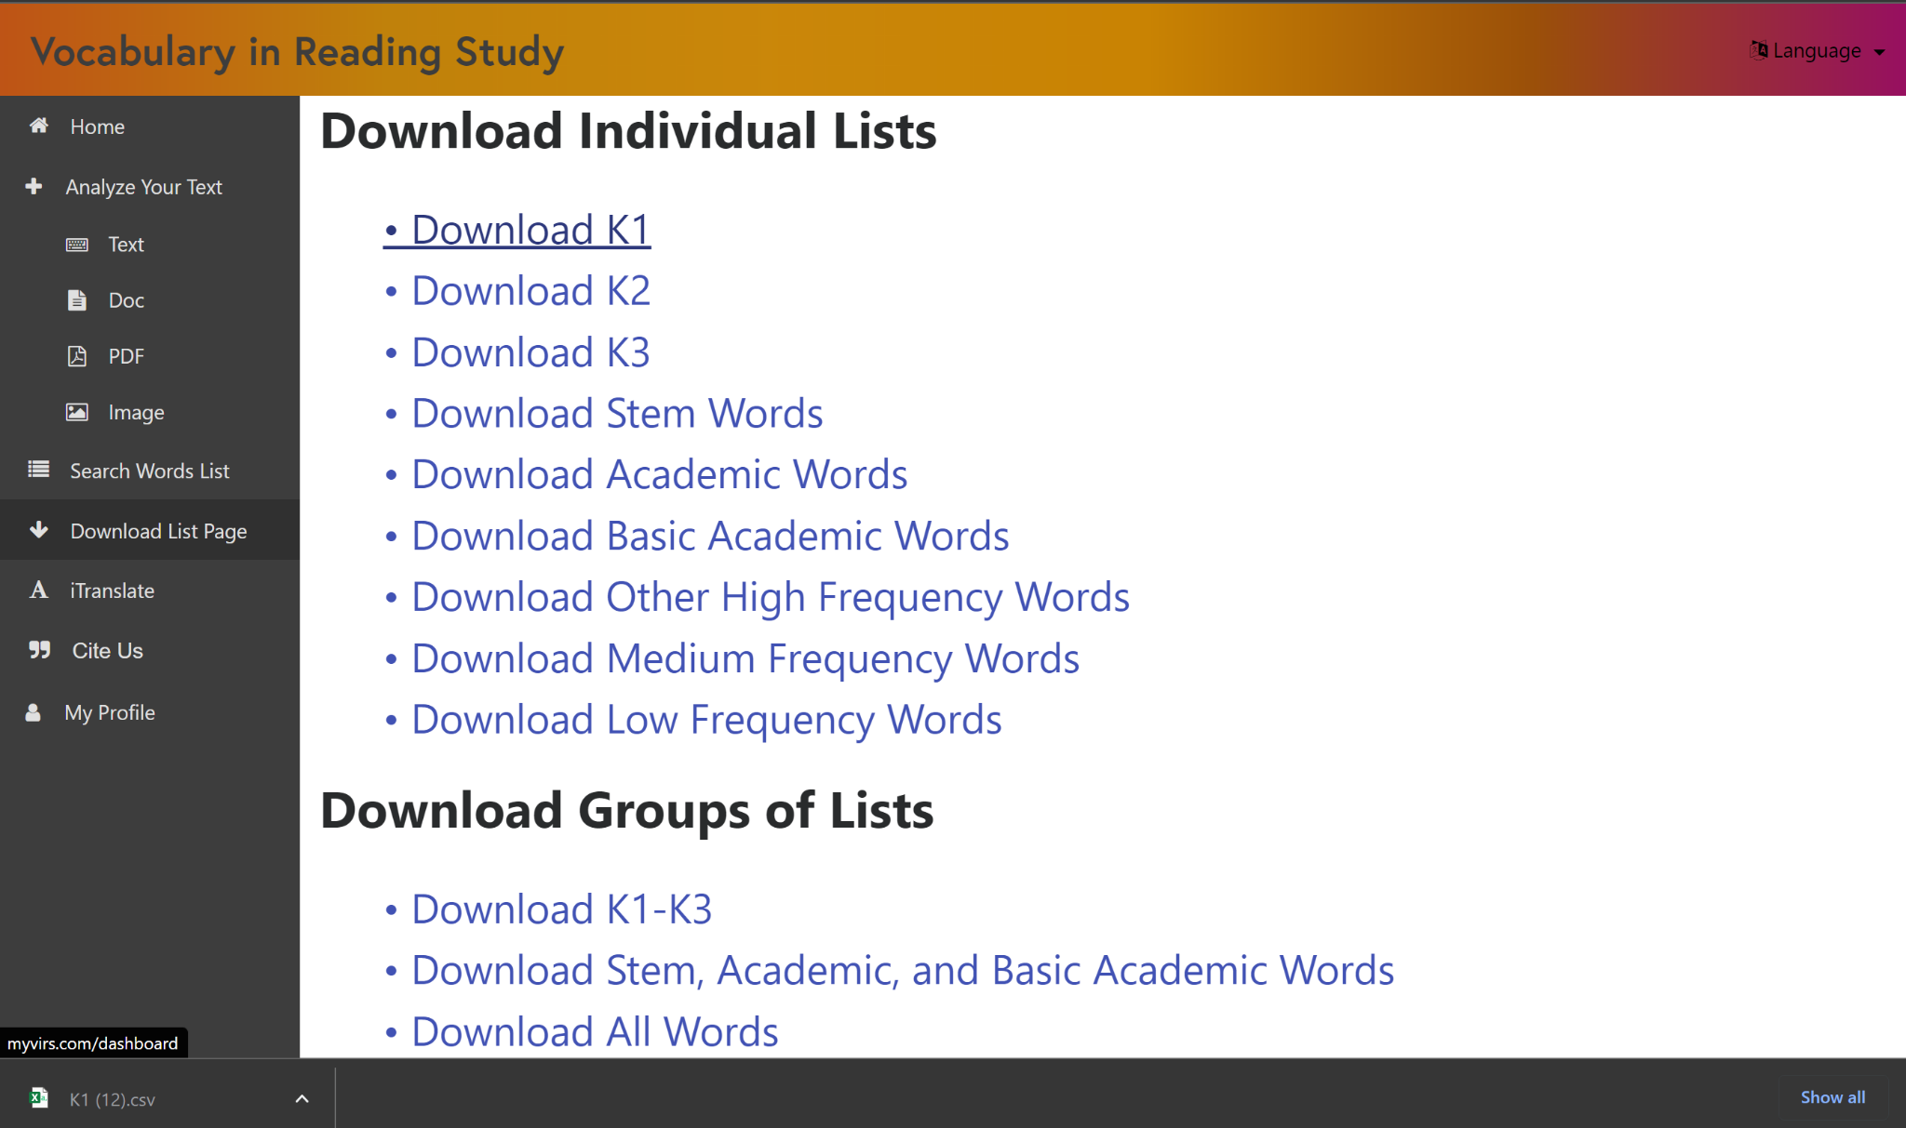
Issue: Can only download words that are currently visible
Problem
Past implementation took a snapshot of the html which it then converted to a csv file.
Solution
Created a new component that uses the database hosted on AWS to download the whole words list.
Download Words List
CSV Download

Slide 30
LIVE DEMO!

